Slide 1

Introduction to Statistics
Ahammad Hossain
Lecturer in Statistics
Department of Natural Science
Varendra University, Rajshahi-6204
E-mail: ahammadstatru@gmail.com
Cell: 01762327094

Slide 2
Goals
3- <number>
Chapter Three
Describing Data: Numerical Measures
GOALS
When you have completed this chapter, you will be able to:
ONE
Calculate the arithmetic mean, median, mode, weighted mean, and the geometric mean.
TWO
Explain the characteristics, uses, advantages, and disadvantages of each measure of location.
THREE
Identify the position of the arithmetic mean, median, and mode for both a symmetrical and a skewed distribution.

Slide 3
Goals
3- <number>
Chapter Three
Describing Data: Numerical Measures
FOUR
Compute and interpret the range, the mean deviation, the variance, and the standard deviation of ungrouped data.
FIVE
Explain the characteristics, uses, advantages, and disadvantages of each measure of dispersion.
SIX
Understand Chebyshev’s theorem and the Empirical Rule as they relate to a set of observations.

Slide 4
Central tendency
Central tendency is a measure of central value or typical value for a probability distribution. It is occasionally called an average or just the centre of the distribution.
Measure of central tendency:
Arithmetic mean
Geometric mean
Harmonic mean
Median
Mode

Slide 5
Characteristics of Ideal measure
(i) It should be easy to understand and easy to calculate.
(ii) It should be rigidly defined i.e., it should have one and only one interpretation.
(iii) It should be based on aH the observations of the series.
(iv) It should be capable of further algebraic treatment i.e., its use in further statistical theory is enhanced.
(v) It should be affected least by fluctuations of sampling.
(vi) It should be affected least by extreme values i.e., too large or too small values.

Slide 6

Characteristics of the Mean
3- <number>
The Arithmetic Mean is the most widely used measure of location and shows the central value of the data.
It is calculated by summing the values and dividing by the number of values.
The major characteristics of the mean are:
  It requires the interval scale.
  All values are used.
  It is unique.
  The sum of the deviations from the mean is 0.

Slide 7





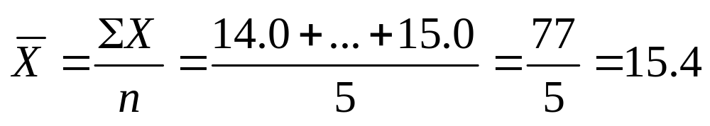
Example 2
3- <number>
A statistic is a measurable characteristic of a sample.
A sample of five executives received the following bonus last year ($000):
14.0, 15.0, 17.0, 16.0, 15.0

Slide 8
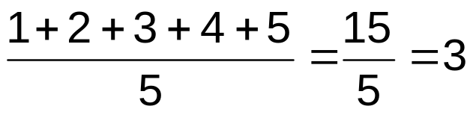
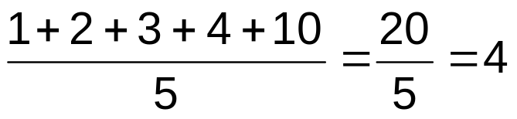
Arithmetic Mean
The most common measure of central tendency
Mean = sum of values divided by the number of values
Affected by extreme values (outliers)
0 1 2 3 4 5 6 7 8 9 10
0 1 2 3 4 5 6 7 8 9 10
Mean = 3
Mean = 4

Slide 9
Properties of the Arithmetic Mean
3- <number>
Properties of the Arithmetic Mean
Every set of interval-level and ratio-level data has a mean.
All the values are included in computing the mean.
A set of data has a unique mean.
The mean is affected by unusually large or small data values.
The arithmetic mean is the only measure of location where the sum of the deviations of each value from the mean is zero.

Slide 10
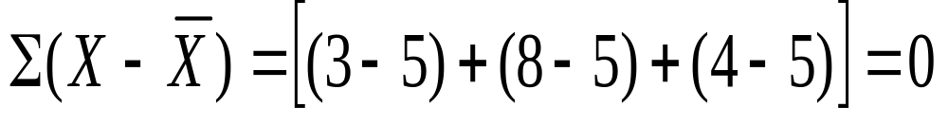
Example 3
3- <number>
Consider the set of values: 3, 8, and 4. The mean is 5. Illustrating the fifth property

Slide 11
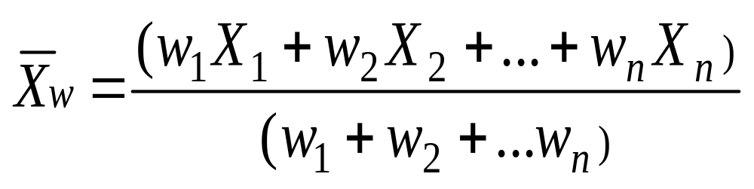
Weighted Mean
3- <number>
The Weighted Mean of a set of numbers X₁, X₂, ..., X_{n}, with corresponding weights w₁, w₂, ...,w_{n}, is computed from the following formula:

Slide 12

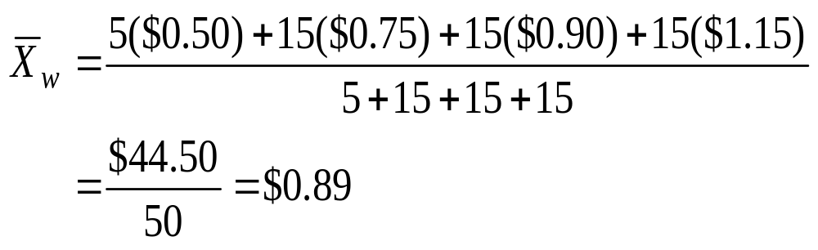
Example 4
3- <number>
During a one hour period on a hot Saturday afternoon cabana boy Chris served fifty drinks. He sold five drinks for $0.50, fifteen for $0.75, fifteen for $0.90, and fifteen for $1.10. Compute the weighted mean of the price of the drinks.

Slide 13
The Median
3- <number>
The Median is the midpoint of the values after they have been ordered from the smallest to the largest.
For an even set of values, the median will be the arithmetic average of the two middle numbers and is found at the (n+1)/2 ranked observation.

Slide 14

The median (continued)
3- <number>
The ages for a sample of five college students are:
21, 25, 19, 20, 22.
Arranging the data in ascending order gives:
19, 20, 21, 22, 25.
Thus the median is 21.

Slide 15

Example 5
3- <number>
The heights of four basketball players, in inches, are: 76, 73, 80, 75.
Arranging the data in ascending order gives:
73, 75, 76, 80
Thus the median is 75.5.
The median is found at the (n+1)/2 = (4+1)/2 =2.5th data point.

Slide 16
Properties of the Median
3- <number>
Properties of the Median
There is a unique median for each data set.
It is not affected by extremely large or small values and is therefore a valuable measure of location when such values occur.
It can be computed for ratio-level, interval-level, and ordinal-level data.
It can be computed for an open-ended frequency distribution if the median does not lie in an open-ended class.

Slide 17
Mode
The Mode for grouped data is approximated by the midpoint of the class with the largest class frequency.
Properties of Mode:
A measure of central tendency
Value that occurs most often
Not affected by extreme values
Used for either numerical or categorical (nominal) data
There may may be no mode
There may be several modes
0 1 2 3 4 5 6 7 8 9 10 11 12 13 14
0 1 2 3 4 5 6
No Mode
Mode = 9

Slide 18
Which measure of location is the “best”?
Arithmetic Mean: It is easy to calculate and understandable. All the observations are included in computing Arithmetic mean.
If one observations is zero then we can’t calculate the Geometric Mean and Harmonic Mean. Both are count all of the observations.
All the observations are not included in computing Median and Mode. Both are less sensitive to outliers.
From the above discussion we say Arithmetic mean is the best measure of location.

Slide 19
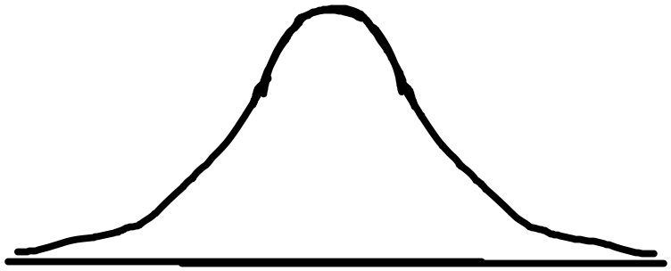
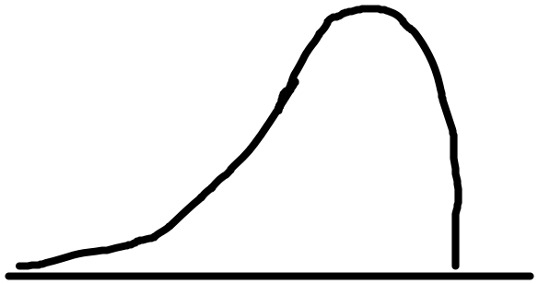
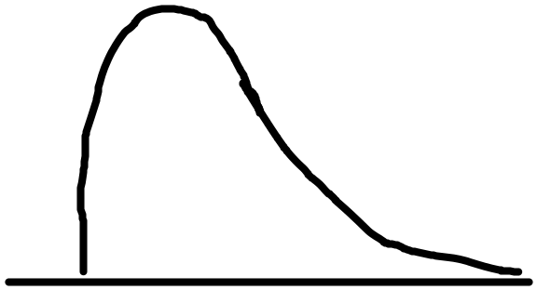
The Relative Positions of the Mean, Median, and Mode
3- <number>
Symmetric distribution: A distribution having the same shape on either side of the center
Skewed distribution: One whose shapes on either side of the center differ; a nonsymmetrical distribution.
Can be positively or negatively skewed, or bimodal

Slide 20
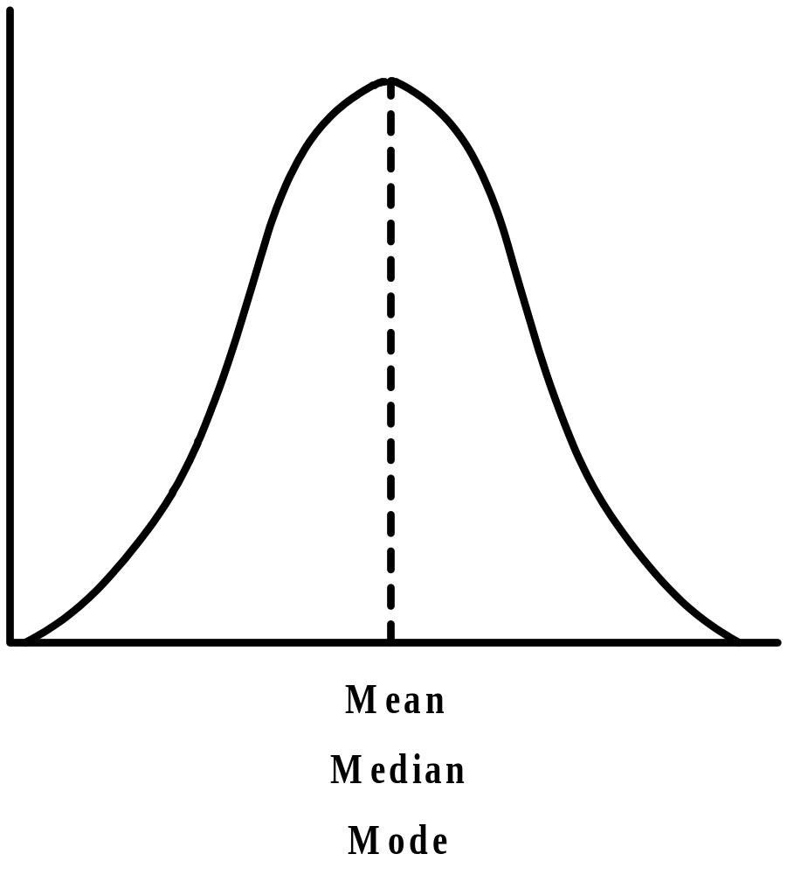
The Relative Positions of the Mean, Median, and Mode: Symmetric Distribution
3- <number>
Zero skewness Mean
=Median
=Mode

Slide 21
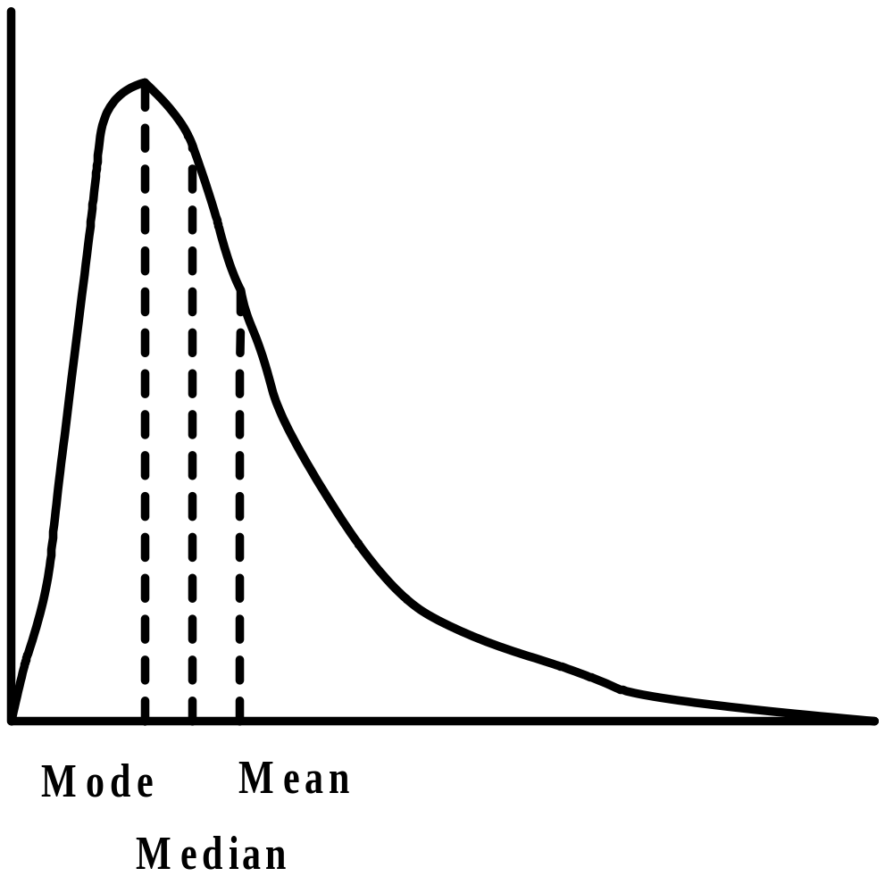
The Relative Positions of the Mean, Median, and Mode: Right Skewed Distribution
Positively skewed: Mean and median are to the right of the mode.
3- <number>
Mean>Median>Mode

Slide 22
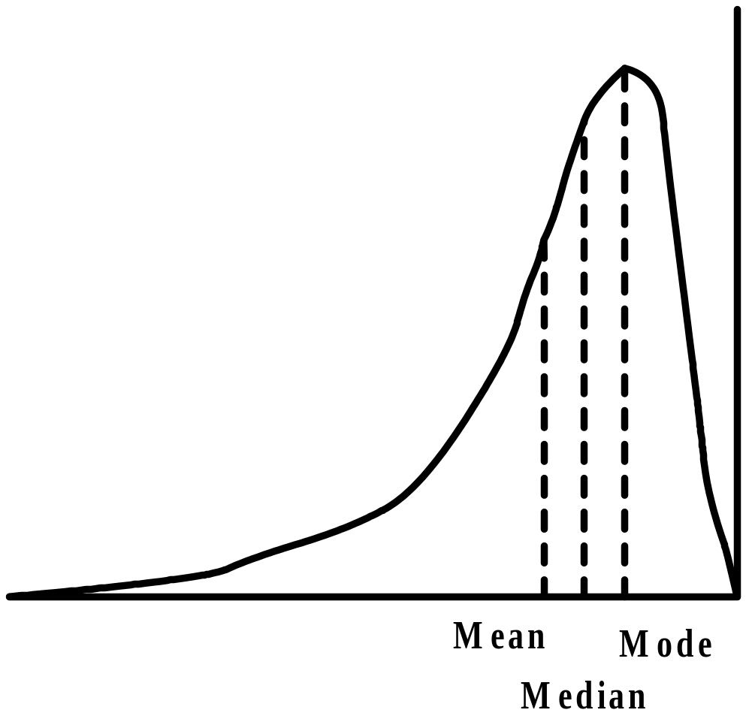
The Relative Positions of the Mean, Median, and Mode: Left Skewed Distribution
3- <number>
Negatively Skewed: Mean and Median are to the left of the Mode.
Mean<Median<Mode

Slide 23
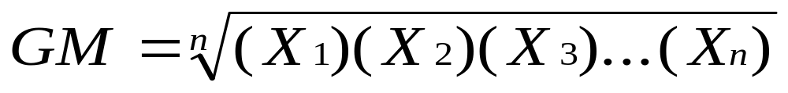
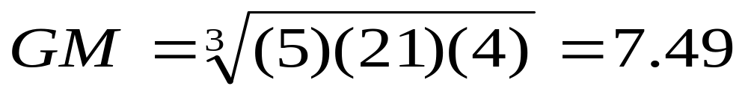
3- <number>
The Geometric Mean (GM) of a set of n numbers is defined as the nth root of the product of the n numbers. The formula is:
The geometric mean is used to average percents, indexes, and relatives.
The interest rate on three bonds were 5, 21, and 4 percent. The arithmetic mean is (5+21+4)/3 =10.0.
The geometric mean is

Slide 24
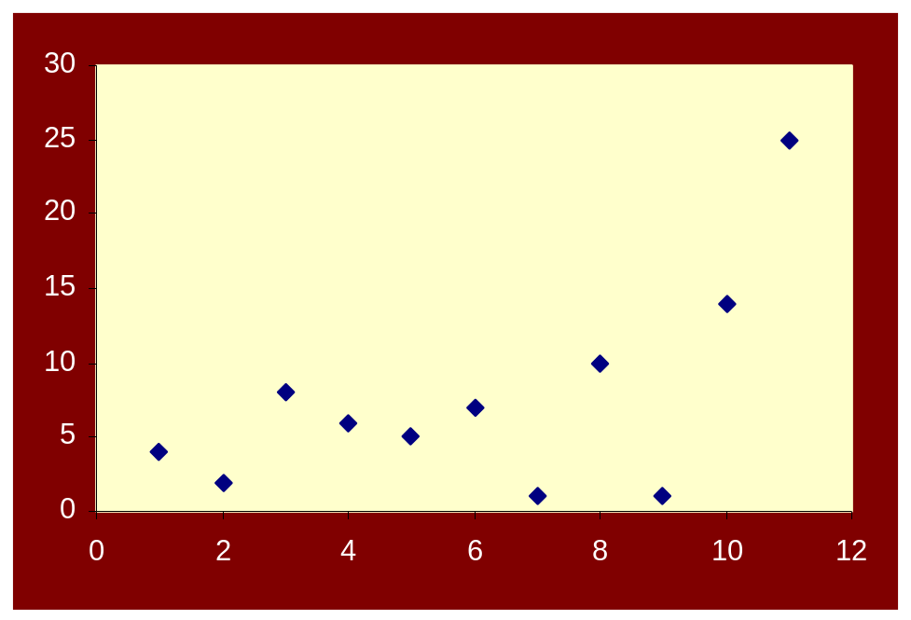
Measures of Dispersion
3- <number>
Dispersion refers to the spread or variability in the data.
Measures of dispersion include the following: range, mean deviation, variance, and standard deviation.
Range = Largest value – Smallest value

Slide 25
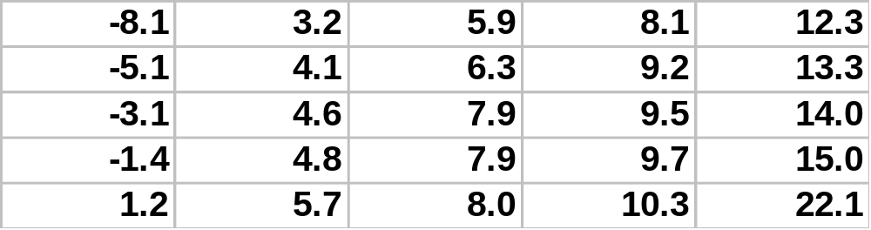

Example 9
3- <number>
The following represents the current year’s Return on Equity of the 25 companies in an investor’s portfolio.
Highest value: 22.1
Lowest value: -8.1
Range = Highest value – lowest value
= 22.1-(-8.1)
= 30.2

Slide 26
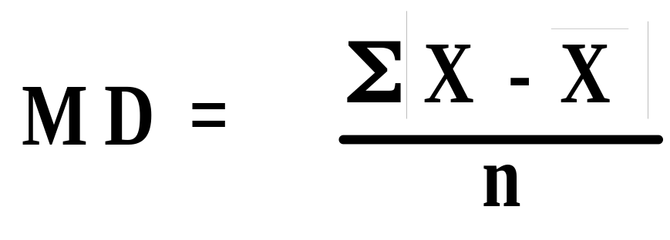
Mean Deviation
3- <number>
Mean Deviation The arithmetic mean of the absolute values of the deviations from the arithmetic mean.
The main features of the mean deviation are:
All values are used in the calculation.
It is not unduly influenced by large or small values.
The absolute values are difficult to manipulate.

Slide 27

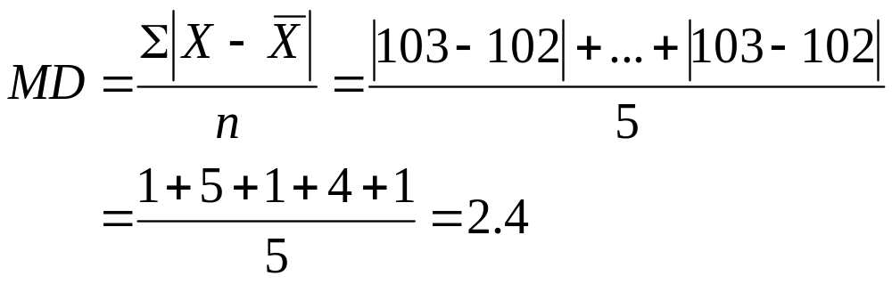
Example 10
3- <number>
The weights of a sample of crates containing books for the bookstore (in pounds ) are:
103, 97, 101, 106, 103
Find the mean deviation.
X = 102
The mean deviation is:

Slide 28
Population Variance
3- <number>
The major characteristics of the
Population Variance are:
Not influenced by extreme values.
The units are awkward, the square of the original units.
All values are used in the calculation.

Slide 29
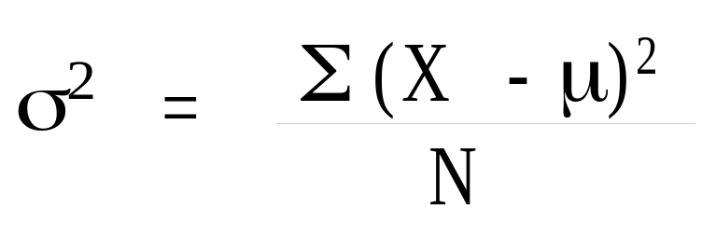
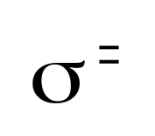
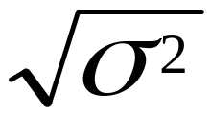
Variance and standard deviation
3- <number>
Population Variance formula:
X is the value of an observation in the population
mu is the arithmetic mean of the population
N is the number of observations in the population
Population Standard Deviation formula:

Slide 30
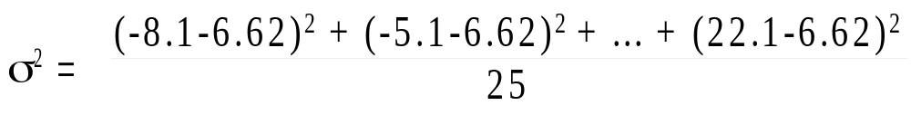
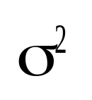
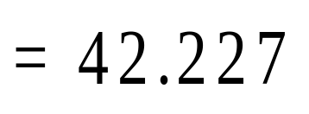
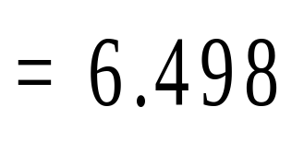
Example 9 continued
3- <number>
In Example 9, the variance and standard deviation are:

Slide 31
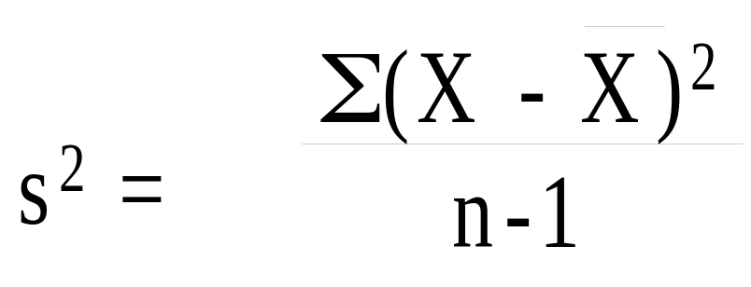
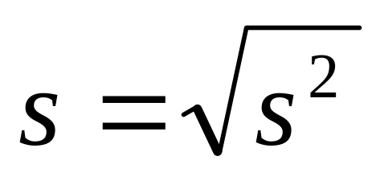
Sample variance and standard deviation
3- <number>
Sample variance (s²)
Sample standard deviation (s)

Slide 32
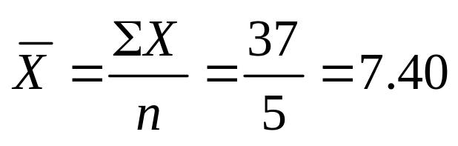
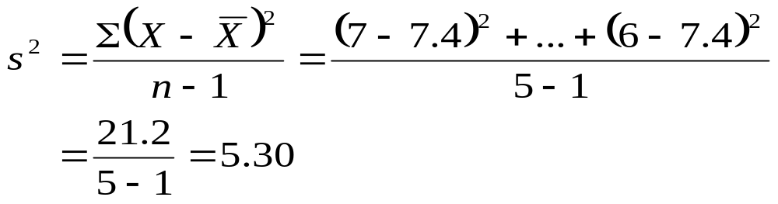
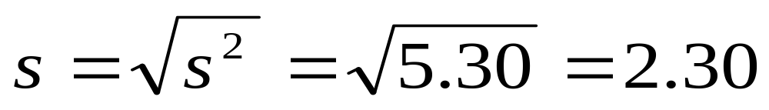
Example 11
3- <number>
The hourly wages earned by a sample of five students are:
$7, $5, $11, $8, $6.
Find the sample variance and standard deviation.

Slide 33
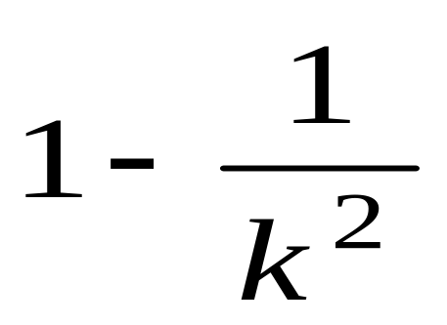
Chebyshev’s theorem
3- <number>
Chebyshev’s theorem: For any set of observations, the minimum proportion of the values that lie within k standard deviations of the mean is at least:
where k is any constant greater than 1.

Slide 34
Interpretation and Uses of the
Standard Deviation
3- <number>
Empirical Rule: For any symmetrical, bell-shaped distribution:
  About 68% of the observations will lie within 1σ the mean
  About 95% of the observations will lie within 2σ of the mean
  Virtually all the observations will be within 3σ of the mean

Slide 35
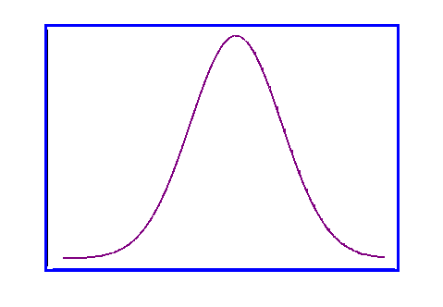
Interpretation and Uses of the Standard Deviation
3- <number>
68%
95%
99.7%
μ−3σ
μ−2σ
μ−1σ
μ
μ+1σ
μ+2σ
μ+ 3σ

Slide 36
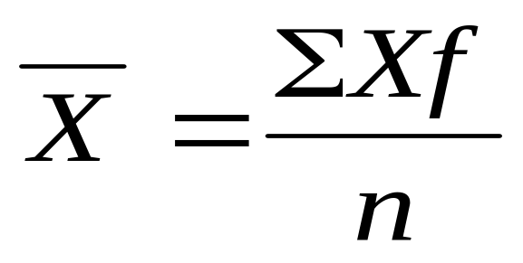
The Mean of Grouped Data
3- <number>
The Mean of a sample of data organized in a frequency distribution is computed by the following formula:

Slide 37
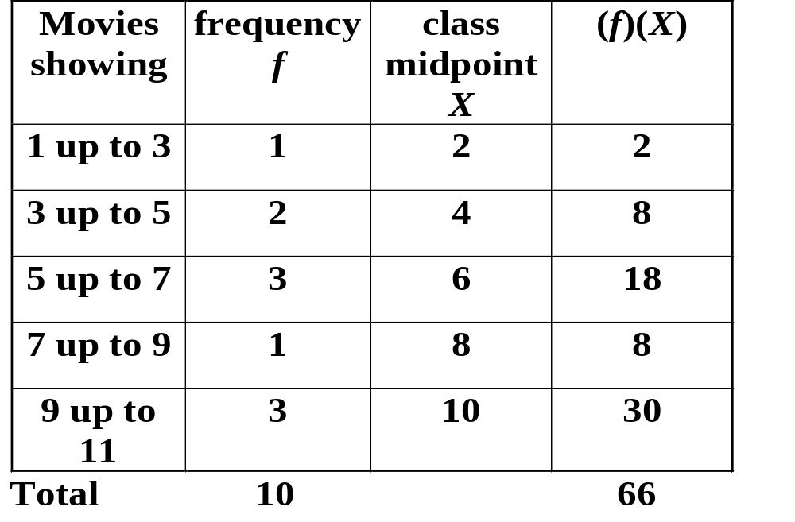
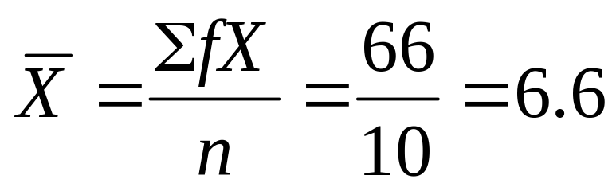
Example 12
3- <number>
A sample of ten movie theaters in a large metropolitan area tallied the total number of movies showing last week. Compute the mean number of movies showing.

Slide 38
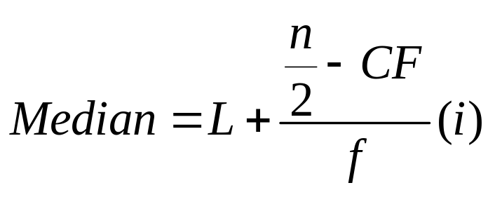
The Median of Grouped Data
3- <number>
The Median of a sample of data organized in a frequency distribution is computed by:
where L is the lower limit of the median class, CF is the cumulative frequency preceding the median class, f is the frequency of the median class, and i is the median class interval.

Slide 39
Finding the Median Class
3- <number>
To determine the median class for grouped data
Construct a cumulative frequency distribution.
Divide the total number of data values by 2.
Determine which class will contain this value. For example, if n=50, 50/2 = 25, then determine which class will contain the 25th value.

Slide 40
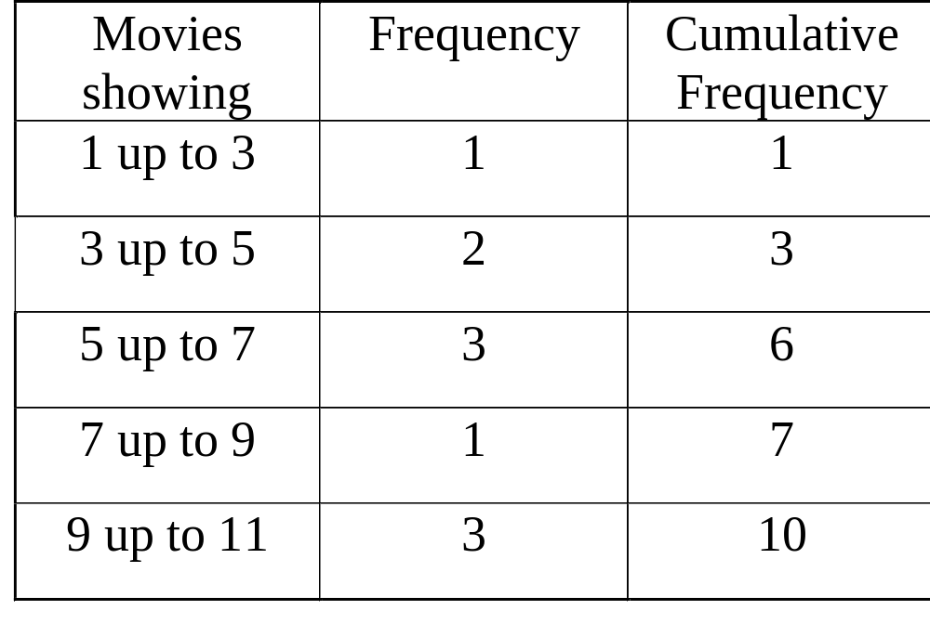
Example 12 continued
3- <number>

Slide 41
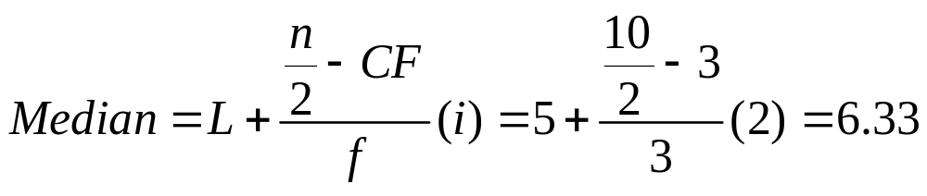
Example 12 continued
3- <number>
From the table, L=5, n=10, f=3, i=2, CF=3

Slide 42
Probable Questions
What is central tendency? Write down the measure of central tendency.
Which measure of central tendency is the best and why?
In a moderately asymmetrical distribution the mode and mean is 23 and 27 respectively. Calculate the median?
Define Arithmetic mean, median and mode. Write down the properties of arithmetic mean and median.
Define formula for arithmetic mean, Geometric mean, median and mode for group and ungrouped data?
Math problem

